Slide 1

Phishing Email Detector: Machine Learning in Action
This presentation showcases a Python and Flask-based system for detecting phishing emails using machine learning.
MUHAMMAD SALMAN (F23605083)
MIAN SHAKAR AFZAL (F23605073)

Slide 2
Introduction
Problem Statement
Objective
Phishing emails pose a significant cybersecurity threat.
Develop a machine learning-based solution to detect phishing emails.
They trick users into revealing sensitive information or installing malware.

Slide 3

Dataset Overview
Dataset Used
Dataset Features
Key Attribute
CEAS\_08.csv
Columns: sender, receiver, date, subject, body, label, urls.
label (1 = Phishing, 0 = Legitimate).
Size: 39,154 entries.

Slide 4
Data Preprocessing
1
Plain Html
Styled Version
2
Added simple functional html.
Added CSS for modern design and better usability.
Key Changes
3
Centralized layout, responsive design, hover effects
for buttons, and color-coded results.

Slide 5
Feature Engineering
Approach
Why CountVectorizer?
Used CountVectorizer for converting email text into numerical data.
Simplifies text representation.
Split the dataset into training and testing subsets (80-20 split).
Ideal for detecting patterns in email text.

Slide 6



Model Selection
1
Logistic Regression
Random Forest
2
Not chosen due to complexity.
SVM
3
Not chosen due to computational cost.
Logistic Regression was chosen for its simplicity and efficiency for binary classification tasks.

Slide 7
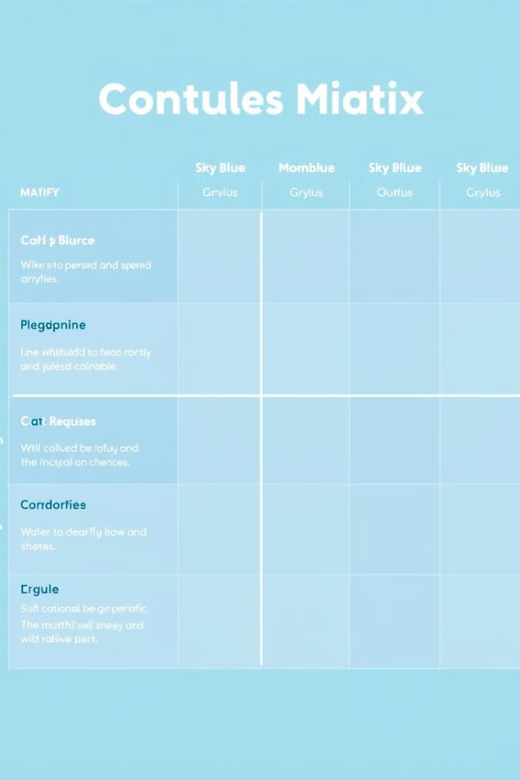
Model Training and Evaluation
95%
93%
Accuracy
Precision
97%
Recall
The model achieved high accuracy, precision, and recall on the test data.

Slide 8
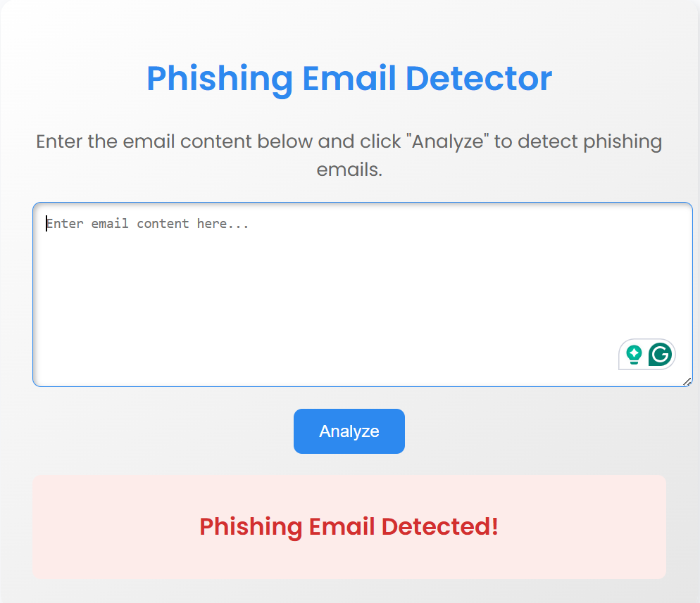


Flask Web App
Input Email
Classification
Enter email content in a text box.
Get immediate classification as Phishing or Legitimate.
The web app provides a user-friendly interface for detecting phishing emails.

Slide 9

Future Enhancements
1
Add support for multilingual emails.
2
Integrate with email services for real-time detection.
3
Use advanced models (e.g., transformers) for improved accuracy.

Slide 10
Thank You!

